Slide 1




MASTER PROGRAM IN
DATA SCIENCE AI & MACHINE LEARNING
www.mcta.co.in

Slide 2



Classification Techniques
www.mcta.co.in

Slide 3
Contents covered
Decision Tree
Entropy
Gini
Variable importance
Parent and leaf nodes
Pruning
2. Random forest
Deepdive into ensembling technique
3. KNN
K-Nearest neighbours classifier theory and example
www.mcta.co.in

Slide 4
Contents covered
4. Logistic Regression
Logit
Sigmoid
Threshold
Elbow method
5. Naïve Bayes
Learn Naïve bayes theorem to classify data
6. SVM
- Learn Support vector machine technique to classify data in n-dimensional space
www.mcta.co.in

Slide 5
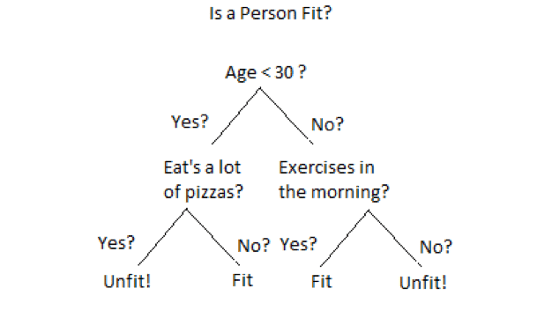
Decision Tree
Decision tree is a classification algorithm that tries to identify the outcome of the data by splitting it into every possible outcome
It works on the if/then principle
Below diagram illustrates how decision tree works in the backend
We can see that each node represents an attribute or feature and the branch from each node represents the outcome of that node. Finally, its the leaves of the tree where the final decision is made.
www.mcta.co.in

Slide 6
Decision Tree
A general algorithm for a decision tree can be described as follows:
1. Pick the best attribute/feature. The best attribute is one which best splits or separates the data
2. Ask the relevant question
3. Follow the answer path
4. Go to step 1 until you arrive to the answer
Below are attributes used to test the decision tree model
Entropy –
The randomness of the data is called entropy, the higher the entropy the more generalized the model will be.
Entropy controls how decision tree splits the data
Gini -
Gini measures how often a randomly chosen sample will be incorrectly classified, hence lower the gini the better
www.mcta.co.in

Slide 7
Decision Tree
Feature Importance –
Feature importance gives a score for every variables in the dataset, the variables with highest score has the highest importance in decision making
Hence this technique helps in dropping variables with low importance that does not add value to model’s learning process
Parent and Leaf node –
Parent nodes are the ones that expand further into various branches while a leaf node is the final outcome and does not expand further, refer to the diagram on the next page
Pruning –
Pruning in decision tree is a technique where we remove the branches that add very less information to the model
www.mcta.co.in

Slide 8
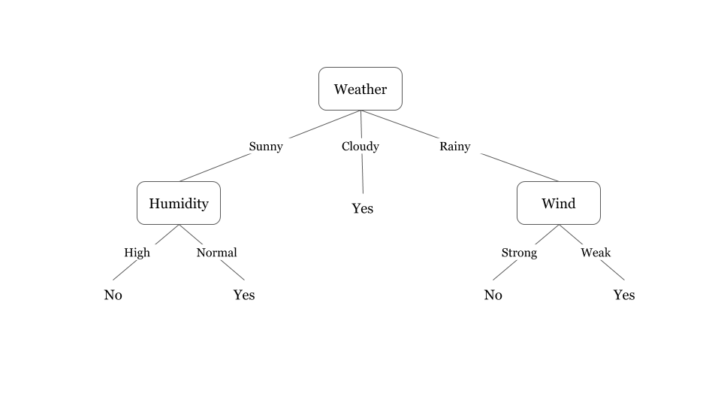
Decision Tree
Decision Tree
We can see that each node represents an attribute or feature and the branch from each node represents the outcome of that node. Finally, its the leaves of the tree where the final decision is made.
Refer to python notebook decision_tree.ipynb for python implementation
www.mcta.co.in

Slide 9
Random Forest
www.mcta.co.in

Slide 10
Random Forest
Random forest in an ensemble of decision tree, meaning its a modified version of decision tree creates multiple decision trees and outputs the mean score
The random forest is a model made up of many decision trees. Rather than just simply averaging the prediction of trees (which we could call a “forest”), this model uses two key concepts that gives it the name random:
Random sampling of training data points when building trees
Random subsets of features considered when splitting nodes
Random sampling of training observations
When training, each tree in a random forest learns from a random sample of the data points. The samples are drawn with replacement, known as bootstrapping, which means that some samples will be used multiple times in a single tree. The idea is that by training each tree on different samples, although each tree might have high variance with respect to a particular set of the training data, overall, the entire forest will have lower variance but not at the cost of increasing the bias.
At test time, predictions are made by averaging the predictions of each decision tree. This procedure of training each individual learner on different bootstrapped subsets of the data and then averaging the predictions is known as bagging, short for bootstrap aggregating.
www.mcta.co.in

Slide 11
Random Forest
Random subsets of features considered when splitting nodes
Random Subsets of features for splitting nodes
The other main concept in the random forest is that only a subset of all the features are considered for splitting each node in each decision tree. Generally this is set to sqrt(n_features) for classification meaning that if there are 16 features, at each node in each tree, only 4 random features will be considered for splitting the node. (The random forest can also be trained considering all the features at every node as is common in regression. These options can be controlled in the Scikit-Learn Random Forest implementation).
Refer to python notebook random_forest.ipynb for python implementation
www.mcta.co.in

Slide 12
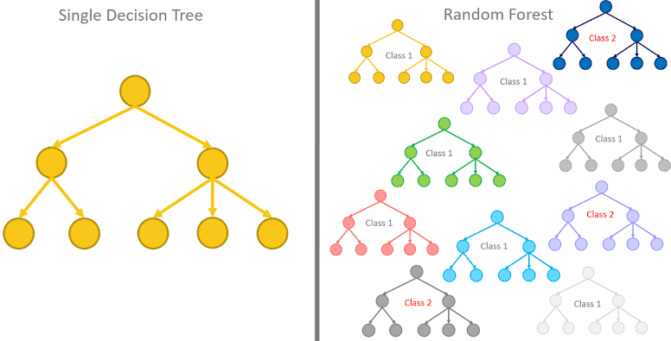
Random Forest
Below diagram represents the difference in Decision Tree and Random Forest
www.mcta.co.in

Slide 13
KNN
www.mcta.co.in

Slide 14
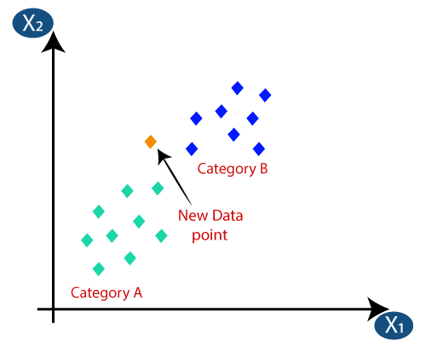
KNN
KNN-
K-nearest neighbors is form of classification technique where n-number of groups are formed and any new data point will belong to the nearest group on the graph
The diagram below illustrates KNN in practice
As shown in the diagram, the new data point will belong to Category B since its closest to that category
Refer to file for knn.ipynb for implementation in python
www.mcta.co.in

Slide 15
Logistics Regression
www.mcta.co.in

Slide 16
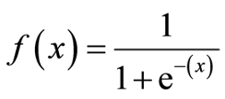
Logistic Regression
Logistic regression is a form of regression model used for classification unlike linear regression which is used for predicting continuous values
The following terms are used in logistic regression model that help with indepth understanding, they are listed below
Logit –
The logit is a transformation. Logistic regression is a regression model.
The logit transformation transforms a line to a logistic curve. Logistic regression fits a logistic curve to set of data where the dependent variable can only take the values 0 and 1. It can be generalised to fitting ordinal data.
Sigmoid –
Sigmoid function is used by LR models to determine the class of the sample, its represented as follows and spits the value between 0 and 1 which tells the probability of the class
Say we got 0.39 as output for class A then there is a 39% chance of a sample belonging to class A
www.mcta.co.in

Slide 17
Logistic Regression
Threshold –
The output of the logistic regression model is in the form of threshold value between 0 to 1
We can adjust the threshold value according to business needs to classify a given sample
For example, we will consider the weather hot if and only if the probability of hot is greater than 0.70 or >70%
Refer to python notebook logistic_regression.ipynb for python implementation
www.mcta.co.in

Slide 18
Naïve Bayes
www.mcta.co.in

Slide 19
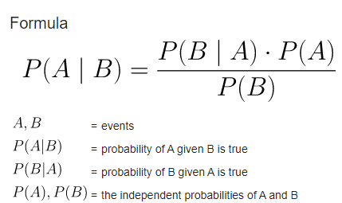
Naïve Bayes
Naive Bayes classifiers are a collection of classification algorithms based on Bayes’ Theorem. It is not a single algorithm but a family of algorithms where all of them share a common principle, i.e. every pair of features being classified is independent of each other.
Naïve bayes works on the principle of prior and posterior probability
Any new sample will be classified keeping in mind it the hypothesis or a condition at hand
For example, the probability of having cancer given we have headace, refer to the equation below
Refer to ‘naïve_bayes.ipynb’ for python implementation
www.mcta.co.in

Slide 20
Support vector machine
www.mcta.co.in

Slide 21

Support vector machine
Support vector machines are a form of supervised machine learning algorithm used for binary and multiclass classification problems
It does so by splitting the data by a best separating hyperplane in n-dimensional space
There are different kernels for SVM (support vector machines)
Such as rbf, Bernoulli, linear and polynomial
Rbf kernel –
Uses Euclidean distance to separate the data into different classes on the graph
Bernoulli kernel–
In layman terms, the Bernoulli principle states that decrease in something leads to increase in something else
Linear kernel–
Separates the the data using a straight line
Polynomial kernel –
Seperates the data using a polynomial function mentioned in the diagram
www.mcta.co.in

Slide 22
Support vector machine
Check python notebook svm.ipynb for python implementation
www.mcta.co.in

Slide 23
Supervised learning
Trivia
Please solve the following questions
Q1) What is a decision tree
Q2) What is entropy
Q3) What is Gini index and what does it say
Q4) What is Random forest and how different is it from decision tree
Q5) How does KNN work
Q6) What is logistic regression and how is it different from linear regression
Q7) What is a sigmoid function, mention the equation
Q10) What is the Naïve bayes algorithm and define the equation
Q11) What are the four kernels of support vector machines, define any 2
www.mcta.co.in

Slide 24

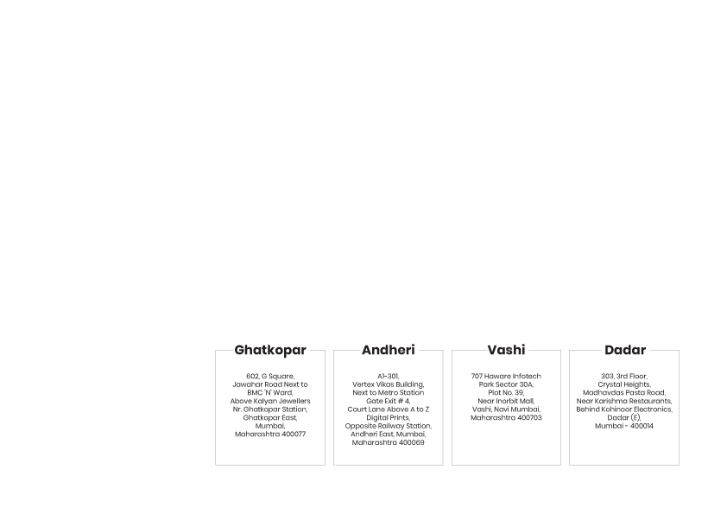
BE AN EXPERT DATA SCIENTIST!
www.mcta.co.in

